Slide 1
YORK YMCA Community Development (YCDC): Intentional act of producing assets that improve the quality of life of neighborhood residents. (Def. Assistance from Brookings Institution)

Slide 3
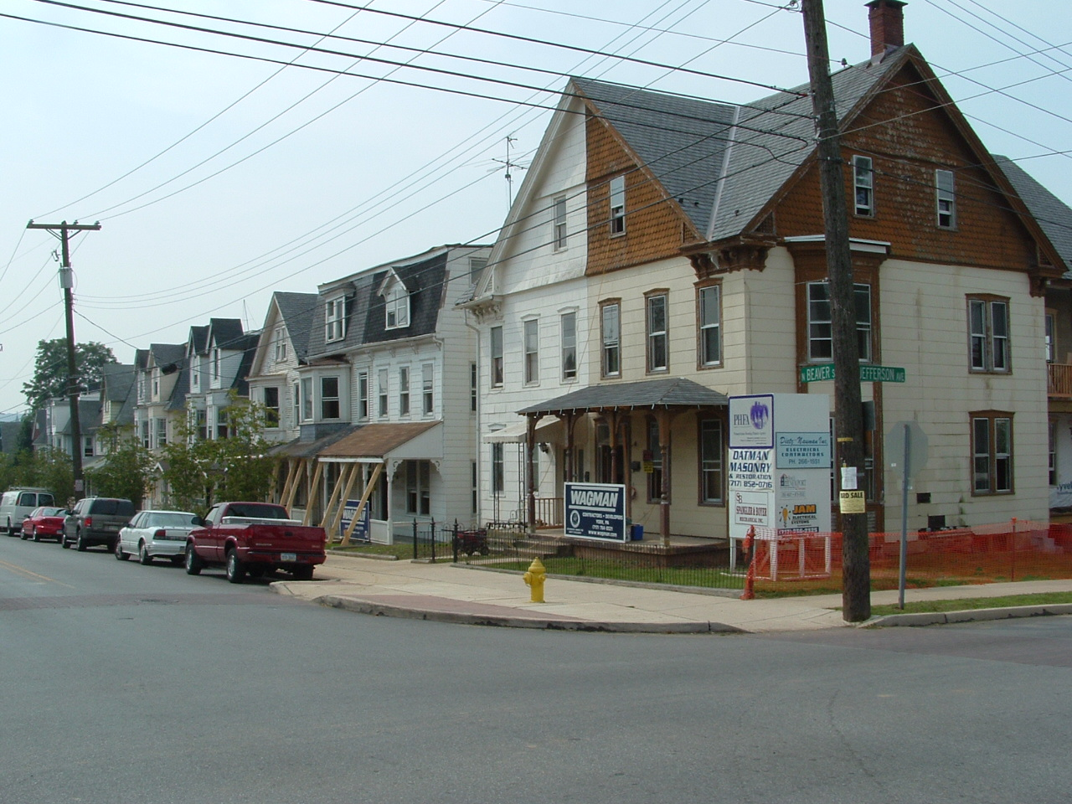

Slide 4
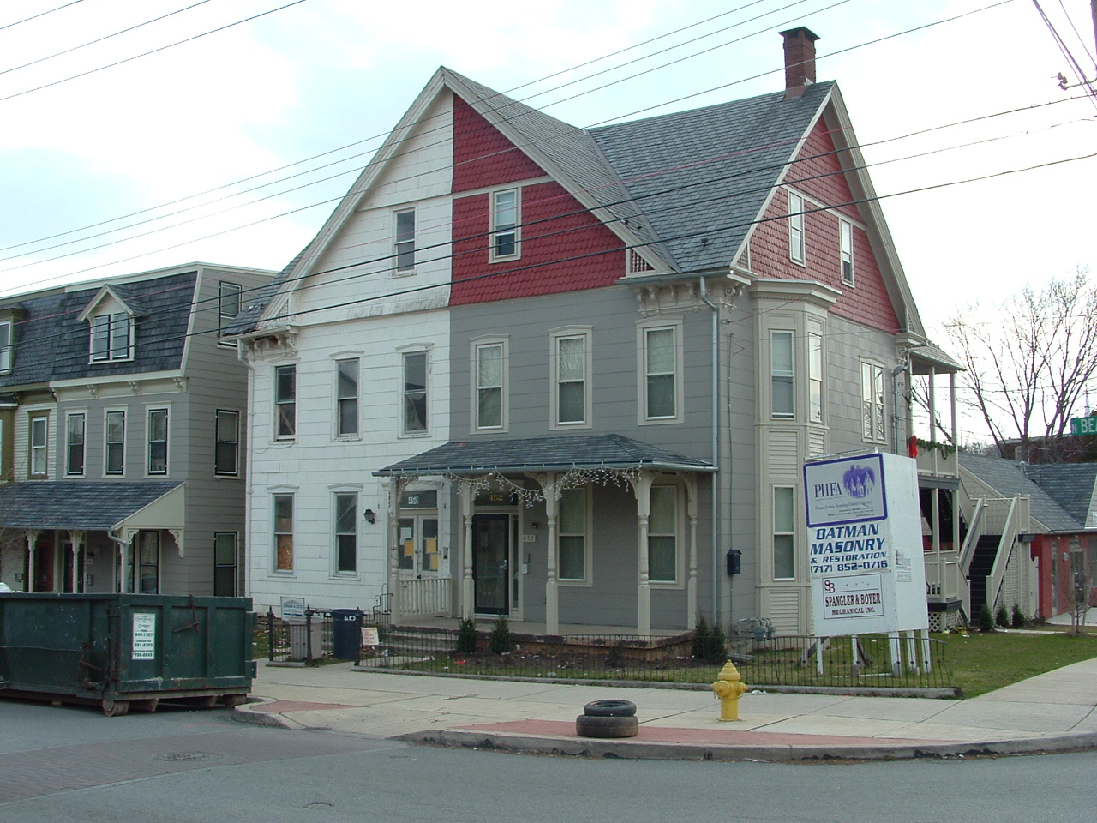

Slide 5
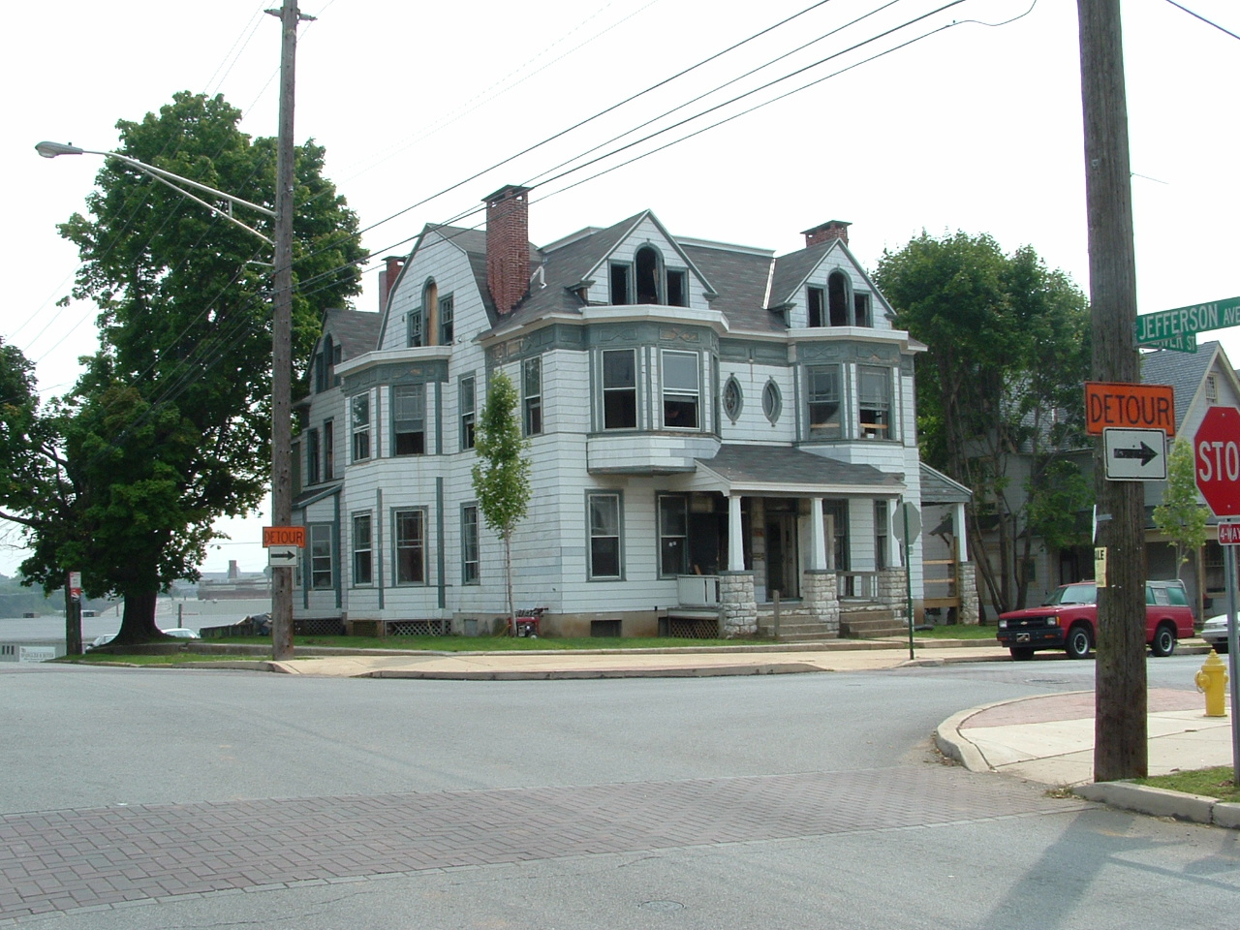

Slide 6
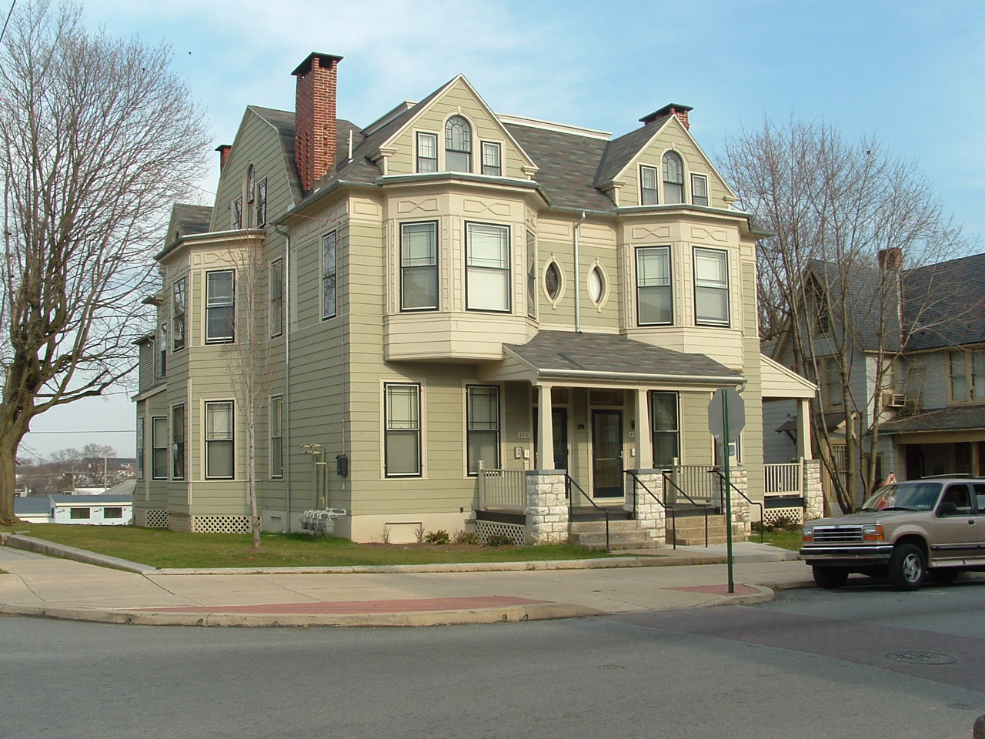

Slide 7
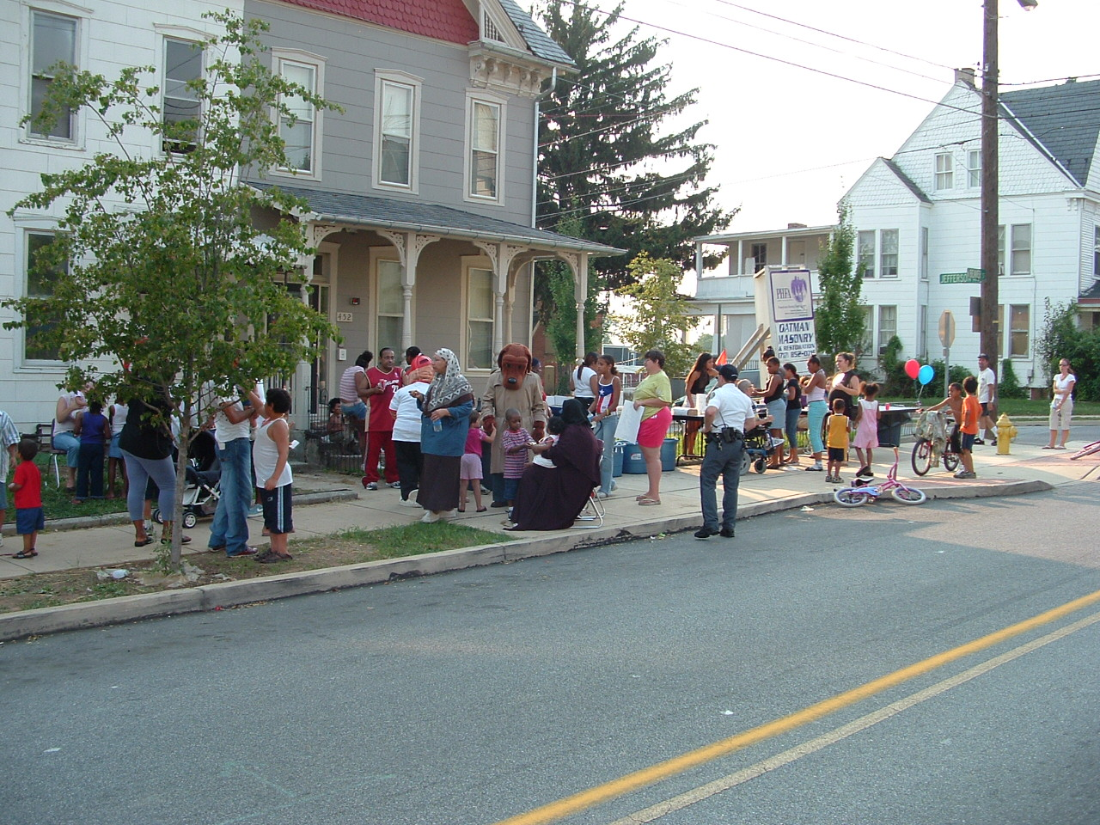

Slide 8
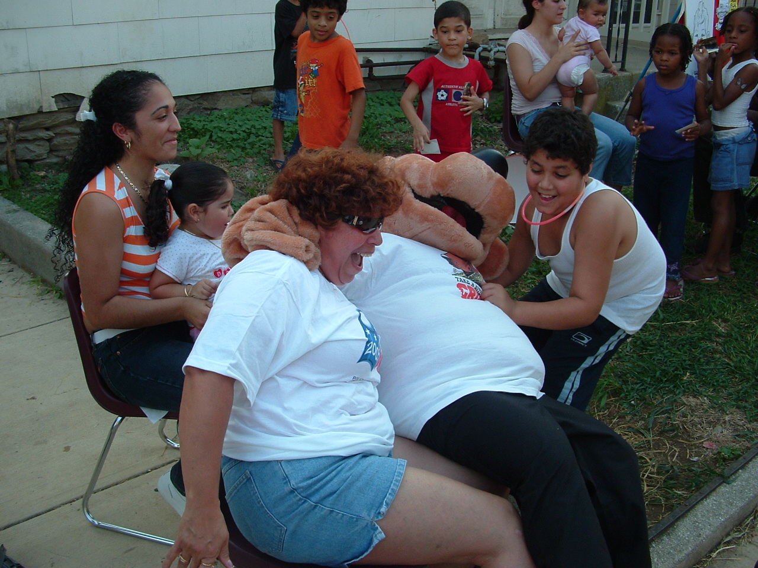

Slide 10
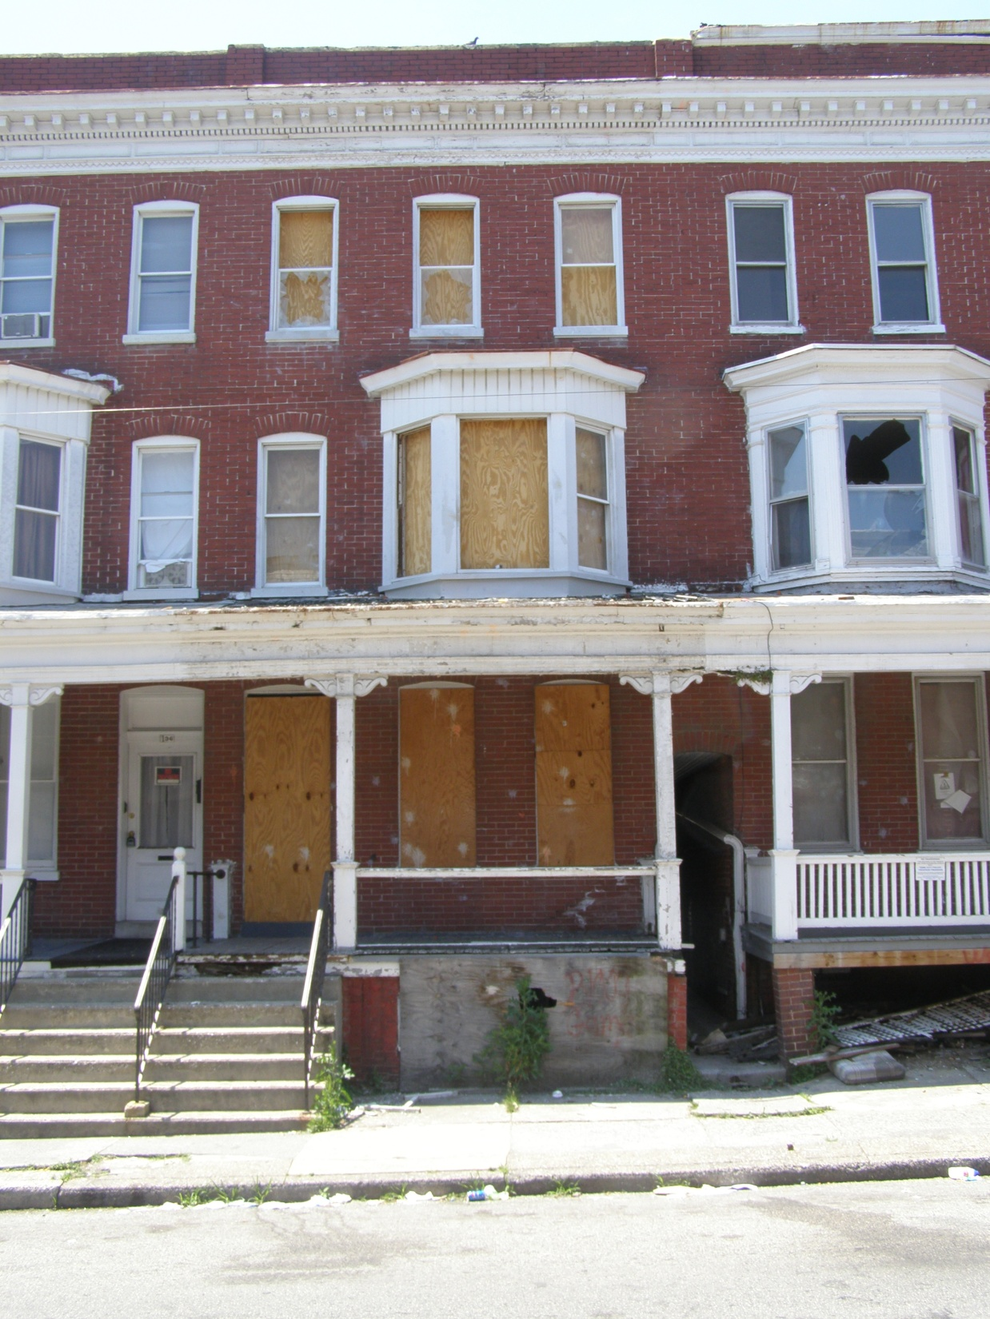

Slide 11
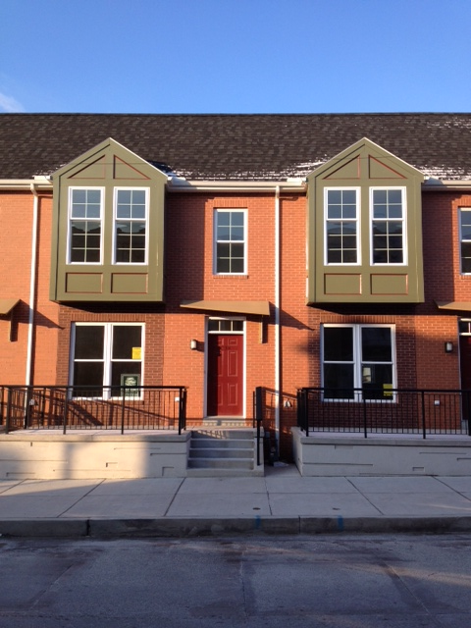

Slide 13
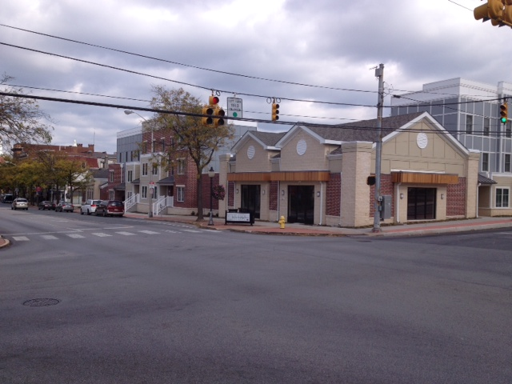

Slide 14
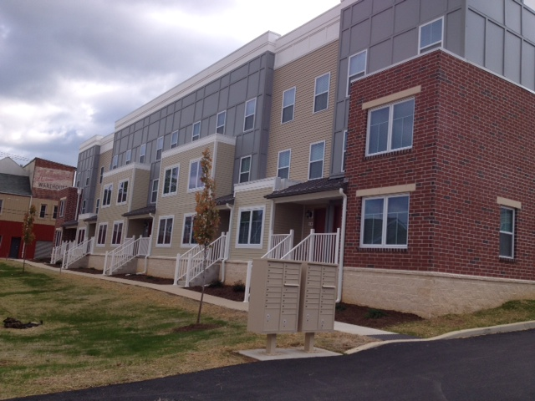

Slide 15
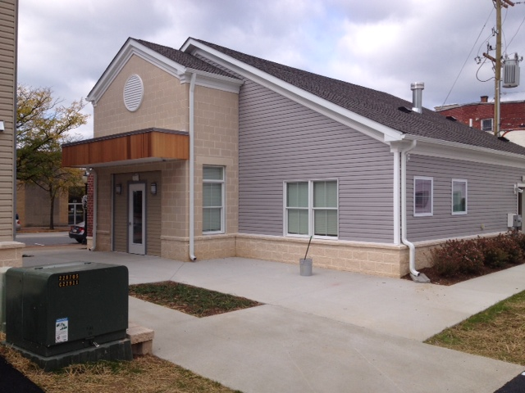

Slide 16
Inside Out Process
Internal capacity of community need to be developed before outside sources are leveraged.
Outside resources have potential to overwhelm and dominate, replacing work of local citizens, institutions etc. – potentially creating dependency.

Slide 17
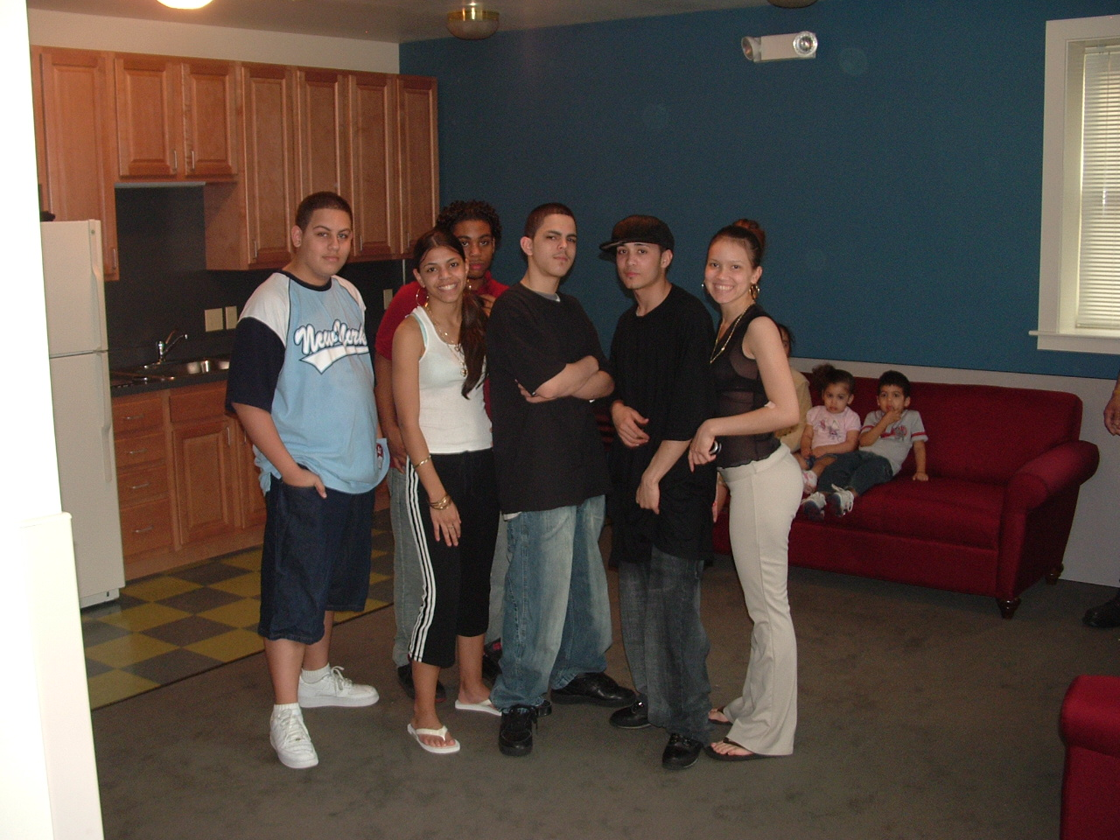

Slide 18
What Has Been Achieved?
Y Men’s Residence (120 SRO, Homeless Men’s Shelter)
SMB (31 units, 6 commercial spaces)
Historic Fairmount (38 units, 3 homes sold)
Salem Square (15 Homeownership)
North Newberry Street (9 market rate units, one home sold)
George Street Commons (28 units, 1 convenience store conversion)
Total Investment – $30M since 1998

Slide 19
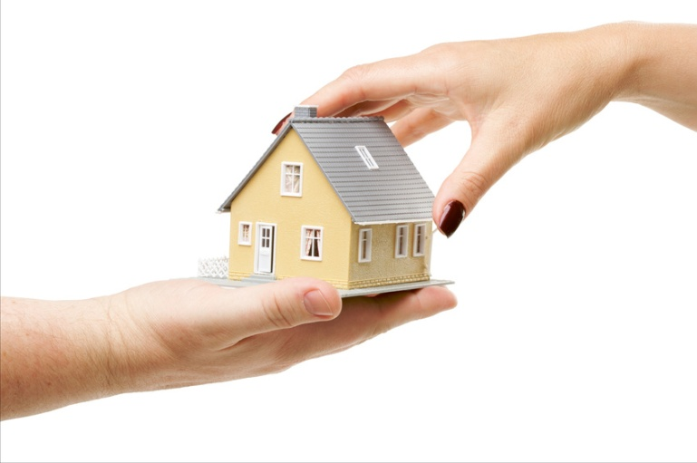
Key Challenges
Resources – Time and Funds
Unknowns
Projects can be risky, costly, in great need of subsidy.
Sustainability of each project over time.

Slide 20
Opportunities
Redevelopment is exciting
Partnerships are formed and deepened.
Visual improvements – enhancing physical assets creates momentum and allows the social and economic conditions to be addressed.
CAUTION: Each domain must be considered. There is too much synergy between the physical, social and economic domains.

Slide 21
Lessons Learned
Risk Taking – Not for the faint of heart.
REAL Partnerships that last.
Vision must be shared.
Perseverance is key!
Project is not over once developed.
Focus on the neighborhoods changed and consequent lives that are changed.

