Slide 1
South Central Housing Summit – Unaccompanied Youth Bill Motsavage - Executive Vice President bmotsavage@valleyyouthhouse.org Ken Kline – Associate Director kkline@valleyyouthhouse.org

Slide 2
The Original VYH

Slide 3
TODAY
Common causes/why?
Overview of the risks
Continuum of housing options
Typical model and case flow
Culture, philosophy, and approach
What makes it work
Funding options and tips
Challenges
Vision/next steps

Slide 4
VALLEY YOUTH HOUSE
Operates in eleven eastern PA counties
Divisions: Prevention/Intervention, Behavioral Health, Shelters/Residential, Independent Living
In 2015:
350 plus homeless youth served by Street Outreach
240 youth sheltered
541 TAY and 154 babies housed by Independent Living

Slide 5
COMMON CAUSES/WHY?
51.2% asked to leave home by family (HHS)
Runaway
80% of females report SA prior to runaway
43% of youth report PA prior to runaway
34% of youth report SA prior to runaway (National Runaway Safeline)
Family homelessness
Economic Issues
Rejection of LGBTQIA youth
40% estimate in Philly (True Colors Fund)
Youth leaving foster care
25% in first year after leaving care (Mid-West Study)

Slide 6
THE NUMBERS AND RISKS
Runaways/homeless youth
One in seven youth ages 10-18 will runaway
1.3 million on a given night
75% dropped out/will drop out
32% will attempt suicide
14% engaged in survival sex (National Runaway Safeline)
Former foster youth at age 24
Median income of $9,000
2/3 of the females on food stamps
40% of the males had been incarcerated (Midwest study)

Slide 7
PROGRAM MODELS
Shelters and Street Outreach
Small group with live in staff
Multi-unit buildings with live in staff
Scattered site apartments

Slide 8
Street Outreach RV

Slide 9
SOP Team

Slide 10
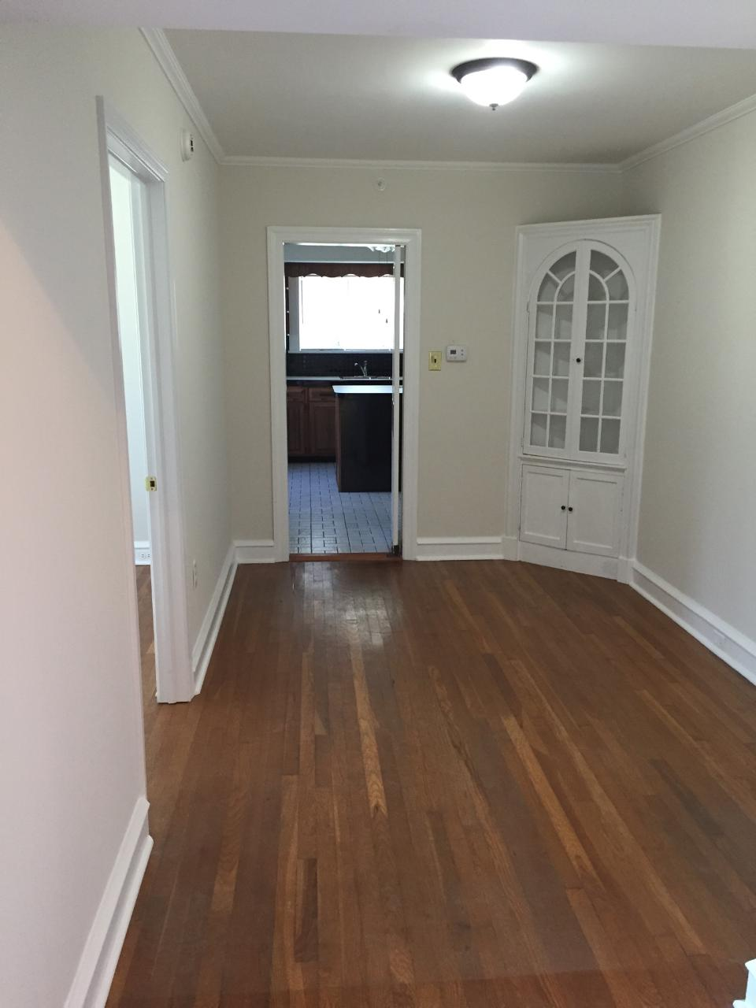
West Chester Transitional Housing

Slide 11
Allentown Mom/Baby Apartments

Slide 12
CONTINUUM OF HOUSING OPTIONS
Most Restrictive Least Restrictive
Lock up RTF Group Home Foster Care Transitional Real world
Low Freedom/Responsibility High
Book Learning Experiential
Limited/Artificial Behavioral Opportunities Realistic
External Control Internal
Unacceptable Mistakes Opportunities
System Driven Decisions and Plans Youth Driven
Artificial Consequences Natural

Slide 13
MODEL AND CASE FLOW
Referral: multiple sources
Screening/assessment: screen in
Acceptance: reduce barriers/housing first
30 day initial plan: domains include financial, housing, education, skills, permanency, documentation, medical, mental health
Client contract
Placement/locate apartment (scattered site)
Move in assistance (scattered site)

Slide 14
MODEL AND CASE FLOW
ISP
Intensive case management: 10 to 1 or less
Move along continuum
Discharge based on client readiness

Slide 15
CLIENT EDUCATION
Apartment hunting
Credit and credit scores
Roommate relationships and searches
Security deposits
Leases and renters rights
Apartment maintenance and repair
Landlord relations
Being a good neighbor
Saying no when you need to
Financial management
Managing family relationships
Everything else!

Slide 16
WHAT MAKES IT WORK?
Philosophy
Relationship based
Understanding of adolescent development
Flexible thinking-shades of gray
Sufficient case management (ration of 10 to 1 or less)
Random check ins
Opportunities to practice IL skills
Other supportive services: food, transportation, start up furnishings, etc.
Who you hire and why
Access to quality clinical services
Connect youth with permanency resources
“Lightest touch”
Track and report outcomes

Slide 17
WHAT MAKES IT WORK?
Know they will mess up: make it difficult to get thrown out
Utilize incentives and external natural behavioral pressure/expectations
“Transition in place” approach with flexibility for scattered site programs
Avoid “drift”
Provide alumni opportunities and support
With/watch/confirm approach
Build a continuum of options
Listen to the youth!

Slide 18
FUNDING SOURCES
Runaway and homeless youth act (RHY): Street Outreach, Basic Center, Transitional Living, Maternity Group Home
HUD: Supportive Housing, Rapid Re-Housing
Local COC: ESG
Local vouchers
Chafee IL program-room and board
Alternative to foster care (for system involved youth)
Special events revenue
Corporate donations (BBB)
Foundations

Slide 19
FUNDING TIPS
Show up (again and again) to your Continuum of Care (COC) and know HUD time frames
Encourage and support youth self-advocacy
Build community awareness of often low-visibility issue – youth count
Seek allies and partners
Demonstrate cost effectiveness and outcomes
Diversify funding – you will need it
Be aware of funding trends
Be opportunistic
Private $ to fill gaps are a necessity
Foundations, corporate donations, adopt an apartment

Slide 21
CHALLENGES
HUD programs often lack supportive service dollars
Lack of appropriate shelter options during housing search
Often complicated grant requirements
Flat funding (RHY example)
Often low admin rate
Small grants = split positions = challenging to manage and track
Youth presenting with increasing challenging issues

Slide 22
2015 RESIDENTIAL IL OUTCOMES
N=165
Housing: 83.2% exited to stable housing
Education: 68% graduated/GED, 15.2% enrolled, 16.8% dropped out
Employment: 64% were employed at exit

Slide 23
VISION
Create a continuum in each county/region
Increase partnerships to create continuum
Obtain flexible funding sources
Provide youth with what they need not what funding source dictates
Bring in increased private resources
Public messaging: heart and wallet!
Increase advocacy

