Slide 1
New Takes on Old Issues: Housing for Special Populations
DIANA MYERS, DIANA T. MYERS AND associates, inc.
South Central Pennsylvania Community Summit
April 15, 2015

Slide 2
Special Populations
People with Disabilities
Seniors
Homeless

Slide 3
Question: What Should We Be Doing in PA in Five Years?
Start with Hindsite

Slide 4
What Was Housing Like for People with Disabilities in 1990?
Housing was SILOED by Population
Seniors Homeless Mentally ill Intellectual Disability

Slide 5
There was Little Choice
People Filled the Next Available Slot
VACANCY

Slide 6
Housing and Services were Bundled
When you have a headache do you go to your landlord??
FOOD
HEALTH CARE
OCCUPATIONAL THERAPY
PHYSICAL THERAPY
SOCIALIZATION

Slide 7
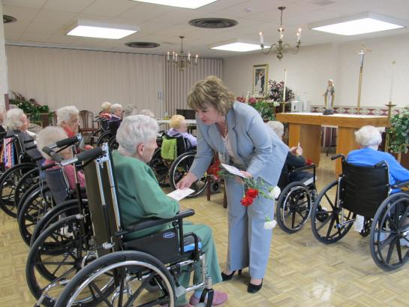
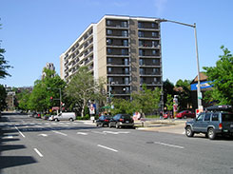
What Was Housing Like for Seniors?
LONG TERM LIVING
>80% Personal Care and Nursing Homes
Little Emphasis on Aging in Place
HOUSING DEVELOPMENT PROGRAMS
High rises
Mix Seniors and Younger People with Disabilities

Slide 8
How about the Homeless?
Living on the Streets
and Doubled -up
Faith-based shelters
HUD funding individual
programs through national
competition

Slide 9
What About Today?

Slide 10
Changes in Housing for People with Disabilities
CHOICE Became a Priority
Self Determination Housing Movement
Separation of Housing and Services
Requires Paradigm Shift in Thinking by Policy Makers, Providers and Staff

Slide 11
People with Disabilities
State Increased Resources/Priorities for Persons with Disabilities
10% Accessible Units
Permanent Supportive Housing
Section 811 Vouchers
Local Lead Agencies
Home Modification Programs
Still Insufficient Housing and Service Resources to Meet
the Need
Developers and Providers Cobble Multiple Resources for Each Project

Slide 12
Changes in Housing For Seniors
Long Term Living
New Goals to “Rebalance Long Term Care”
Increased Emphasis on Home and Community Based Services
Continuing Care Retirement Communities
Aging in Place
Age Friendly, Livable, Life Long, Elder-Friendly Communities

Slide 13
Housing For Seniors
Senior Housing
Independent Retirement Communities
Elderly Only Subsidized Buildings
Non Traditional Housing Options

Slide 14
Changes in Housing For Homeless
McKinney Act 1994
Coordinated Networks of Homeless Housing
and Services (Continuums of Care)
Priorities
Housing Emphasis
Mainstream Resources
Ending Chronic Homelessness

Slide 15
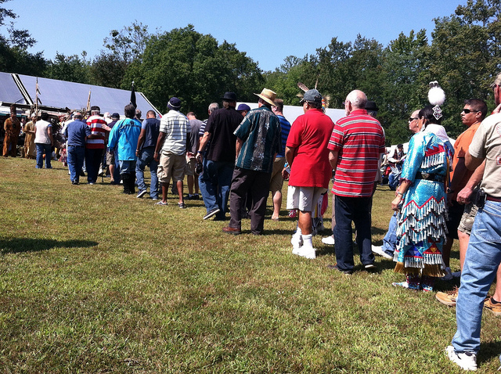
Housing For Homeless?
HEARTH Act 2009
Emphasis on Diversion, Prevention, Rapid Rehousing and Permanent Housing
Ending Veterans and Family Homelessness
Emphasis on Housing Only
Focus on Performance
Measures and Outcomes

Slide 16
What Should We Be Doing Five Years from Now?
Foresight

Slide 17
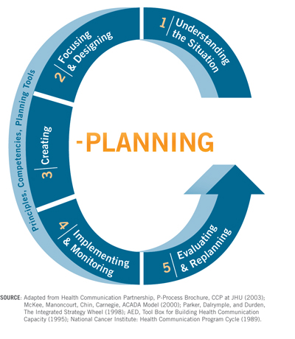
1- Improved Assessment and Planning for All Individuals
Quality Assessment and Planning Tools for Housing and Services for all Populations
Experts Available to Assist Consumers, Families, and Providers to:
Identify Needs
Create Housing Plans
Carry out Plans
Plan early if possible

Slide 18
2- Single Strategy for All Special Needs Populations
Goal: To Maximize Individual Choice
Separation in Delivery of Housing and Services
HOUSING
-----------
SERVICES

Slide 19
3-Expanded Affordable Housing Opportunities
Comprehensive Range of Housing Options
Informed Choice
Provided By Housing Industry Professionals
Flexible Programs and Initiatives:
Incentives to landlords
Support for Nonprofit Developers
Capacity Building
Seed Money for Start-up
On-going Operations
Support for Innovation and Pilot Projects

Slide 20
4- Expanded Supports and Services
Provided by Human Service
Professionals
Easily Accessible
ADRC LINKs
Flexible
Money Follows the Person
Meet Individual Needs
Maximize Choice and
Control

Slide 21
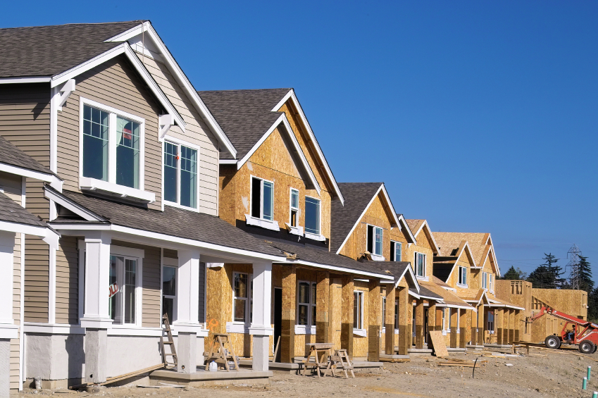
5- Ensure Sufficient Funding for Housing and Services
HOUSING
PHARE
Rental Assistance
New Construction
Rehabilitation
Home Modifications
Emphasis on:
Accessibility, Visitability,
Universal Design

Slide 22
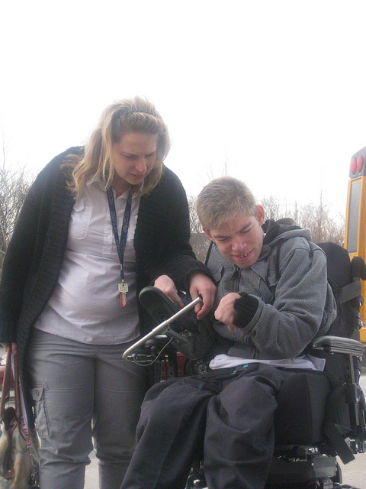
5- Ensure Sufficient Funding for Housing and Services
SUPPORTS AND SERVICES
Home and Community Based Services
Nursing Home Transition
Money Follows the Person
Workforce Development
Family Support

Slide 23
6- Promote Creative Resource Development
Assess and Shift Current Resources to Address Priorities and Needs
Generate New Resources
Partnerships- Hospitals, Managed Care, Foundations, etc.
Housing Trust Funds
Tax Credits

Slide 24
7- Advocate for Long Term Solutions
Address Long Term Issues of Poverty and Self- Sufficiency
Expand Permanent Housing and Employment
Initiatives

Slide 25
Long Term Solutions
State Level Task Force to:
Promote All Options, including Non-Traditional Options
Identify and Remove Regulatory and Policy Obstacles
State Follow-up
Prepare and Deliver Training
Provide Technical Assistance

Slide 26
Consider Your Role
Don’t Take a Back Seat
Be a Driver in Advocating for Change!

