Slide 1
Plenary Discussion re: Public Housing Authorities
South Central Pennsylvania Regional Housing Summit
June 14, 2016

Slide 2
History
1890s – Federal Government studies urban slums
1937 – U.S. Housing Act establishes Public Housing Program
1940s-50s – Widespread construction of Public Housing
1960s – Social issues begin to emerge in many large urban PH communities-
Cabrini Green, Marcy Projects, Robert Taylor, etc.
Source: U.S. Department of Housing & Urban Development website

Slide 3
History (cont’d)
1965 – Housing and Community Development Act creates the Department of Housing & Urban Development (HUD)
1974 – The Housing and Community Development Act establishes the Section 8 program
1990s – HUD establishes HOPE VI program to demolish some troubled Public Housing communities and replace with mixed-income developments
Source: U.S. Department of Housing & Urban Development website

Slide 4
Background
Approximately 3,400 Housing Authorities in the U.S.
Pennsylvania has 89 authorities.
Ranging in size from small towns to Philadelphia, PA (HA is one of top ten largest in the nation at around17,000 affordable housing units and 18,500 HCV).
HHA – 1,751 units in 10 locations* – built between 1940 – 1963 (*79 of the units are scattered single family units).
Approximately 1.2M units of Public Housing in the U.S.
Approximately 2.1M Housing Choice Vouchers in the U.S.

Slide 5
Structure
Housing Authorities are typically enabled under State law
Serve local jurisdictions (Cities, Municipalities, Counties, etc)
Administer mostly or exclusively Federal Funds
Typically must comply with all federal, state and local regulations, laws and ordinances
Typical Appointing Entity = Unit of Local Government
In Harrisburg, the Mayor appoints the 5 member Board of Commissioners (including 1 Resident Representative)
They serve five year (5) terms.

Slide 6
Federal Partnership
Funds provided through the U.S. Department of Housing and Urban Development (HUD)
HUD Regulations dictate the majority of Programmatic Policies
Contractual agreement = Annual Contributions Contract (ACC)

Slide 7
Primary Programs
Federal Funds rec’d in 2015:
Harrisburg Housing Authority (HHA) = approx. $22M
To operate and support two programs that assist income qualified households
Public Housing (PH)
Rental Units owned and operated by the HA –
participants pay 30% of household income towards rent
-For HHA a minimum rent of $50.
Housing Choice Voucher Program (HCVP)
Subsidies that support income qualified households within privately owned rental units – participants pay 30% of household income towards rent

Slide 8
Typical Funds
Housing Choice Voucher (HAP – housing assistance payment)
Capital Fund
Operating Fund
Resident Opportunity and Self- Sufficiency

Slide 9
Mission
Provide decent, safe and affordable housing.
HHA’s stated mission:
Provide quality and affordable housing;
Work unyieldingly towards improving the quality of life for our residents;
Aggressively focus on programming for individual and family self-sufficiency;
Develop and maximize assets and resources for the benefit of our business interests; and
Affirmatively promote fair housing.

Slide 10
Housing Choice Voucher
The majority of voucher users are families with children.
Families with Children • 59% of all Section 8 households are families with children. • More than 2,357,977 children live in Section 8, representing 50% of all Section 8 residents. • 48% of households with children obtain their primary income from wages.* • The average income for a Section 8 family is $11,049.

Slide 11
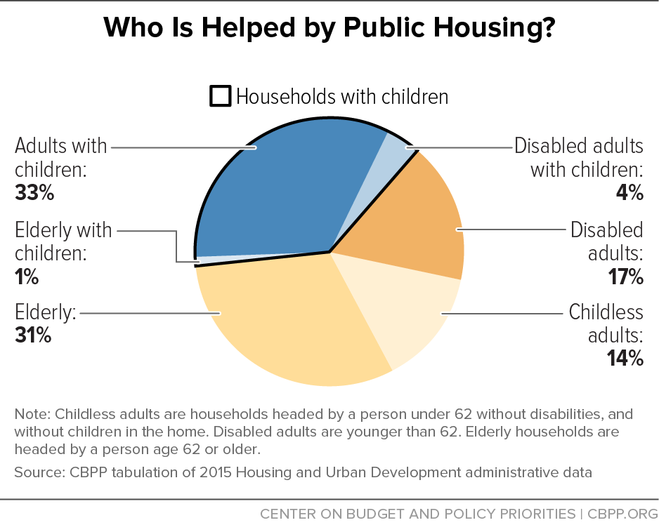
Public Housing Program
There are approximately 1.2 million public housing units owned and managed by more than 3,000 housing authorities. 38% are families with children.

Slide 12
State of Public Housing
$26 billion in unmet capital needs;
Annual prorations to Operating Subsidy;
Annual prorations to Capital Grant program;
Recapture

Slide 13
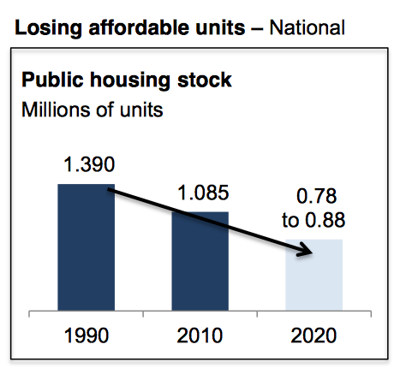
Losing Ground
Public Housing Nationally:
Estimated to drop by 37% by 2020;
Not being replaced by new vouchers
Public Housing in Harrisburg:
Will be faced with replacing, at a minimum, 300 public housing units over the next 5 years.
Affordable Housing in Harrisburg:
66% of population are Low-Moderate-Income (LMI) persons
In 2014, it became official - All 15 census tracts in Harrisburg now contain a Majority of LMI persons.
Estimates made by Abt Associates, Inc
According to West Penn Rural Fair Housing

Slide 14
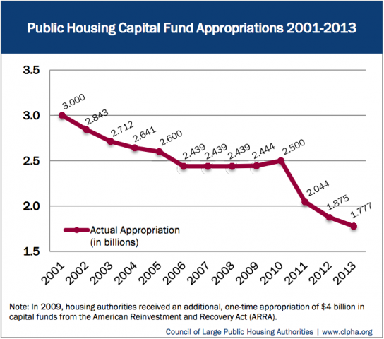
Breaking down the numbers: Capital Funds for PHAs

Slide 15
A New Frontier for Public Housing Authorities
We are all programmed to judge success and winning in relation to how fast we can produce results. Seldom are people generous enough to give us time to cultivate ourselves, even though that cultivation would bring greater fruit.
-Chin Ning Chu

Slide 16
Harrisburg Housing Authority’s
Summer Growth Program
Aggressively focus on programming for individual and family self-sufficiency.
In 2014, we developed a pilot “Growth Program” which established an Environmental Teen Corp. (ETC).
Program was paid for in large part with City funds through the Environmental Advisory Council. $1,000 stipend per teen.
Teens 13-16 were eligible to participant. Limited participation to 25 teens.
Pilot year was a one month period that ended the weekend before school started.
The working hours for the teens were from 9am-3:00pm
The meeting place for the teens was at the HACC campus (Midtown). We wanted to introduce the teens to a college atmosphere. We met at HACC Monday through Thursday.
We met at the Midtown Scholar Bookstore on Fridays. Again, we wanted to introduce the teens to an educational reading environment.

Slide 17
Environmental Teen Corp
Objective #1 The ETC was to help keep the City of Harrisburg clean by engaging in neighborhood clean-up, painting, riverfront clean-up, trash pickup, etc.
One of our main objectives was to get the teens to understand how important it was to keep their own community clean and help beautify the City.
Objective #2 Develop healthy eating habits and appreciate business concepts
The Learning Lunch Program was the perfect idea to educate our teens about the importance of healthy eating. This program was designed to teach the teen’s healthy eating habits, restaurant etiquette, how different cultures and people in differing income levels view food, and the restaurant business and job opportunities of how to run a restaurant. The Learning Lunch Program was also designed to give back to City owned restaurants
Objective #3 The teens would learn about different career opportunities
We designated Thursdays and Fridays for environmental and educational tours and speakers.

Slide 18
Environmental Teen Corp
2015, the program increased the number to 40 teens and 5 college student mentors.
2016, the program is increasing to 80 teens and 8 college student mentors. The program will last an additional two (2) weeks for a total of a month and a half.
Stipend increases to $1,500.
The City will contribute $125,000 and Capital Region Water contribute another $50,000.

Slide 19
July, 2014 | Capital Area Transit – NEWS RELEASE
CAT Hosts HHA Summer Youth Students Visit
(Harrisburg) – CAT staff will host a transit class for Harrisburg Housing Authority students in August as part of HHA’s summer growth program for youth. The three-hour class will include a tour of CAT’s facility and a presentation of the environmental impact of using transit, as well as transit career options, and operational information. For more information about the program, visit here.

Slide 25
Inspired by…?
A local teacher contacted our coordinator and said during the summer he would see the teens working and sometimes see them at the ETC "Learning Lunch". During the first week of school, he had five of the ETC teens in his class. He asked the kids about the program, the teens lit up with excitement and started talking about the program. The kids were so engaged in talking about the program that the other students in the class were all asking how they could get into the program.
The teacher praised the teens by saying he noticed a significant change in their maturity level and that in his opinion there was no other experience, other than the Summer Growth Program, that could have provided that change in maturity.

Slide 26
Contact information: Senghor Manns, CEO and President The Harrisburg Housing Authority Email: smanns@harrisburghousing.org Phone: 717-257-4945 Address: 351 Chestnut St., 12th floor ste. Harrisburg, PA 17101

