Slide 1
MOLD
The New Four Letter Word
“Gone”

Slide 2
Overview
Mold
Available Options
Inventor of Technology
MoldExterm System
Utilizing the New Technology Surface Management Treatment System (SMTS) A & B
Dehumidification
Benefits of System
Mold in the Wall
Additional Supporting Information
Company Information
Conclusion / Questions

Slide 3
Mold
Myths
Bleach kills mold
Dead mold is fine
Not all molds are harmful
Truth
There are over 100,000 different molds
Mold needs four things to grow and populate
Moisture
Temperature
Moving Air/Oxygen
Carbohydrates
Anything that was living at some point

Slide 4
Mold
Most Common Molds
Stachybotrys produces airborne toxins. These molds can cause breathing difficulties, dizziness, memory and hearing loss, and flulike symptoms.
Cladosporium and Penicillium are more commonly found molds but these molds can cause allergic reactions, asthma, breathing problems, sinus infections, headaches, coughing and eye and throat irritation.
Memnoniella and Aspergillus versicolor are two types of mold that can produce airborne toxins. They produce mycotoxins and can cause even worse problems. These problems are chronic fatigue, loss of balance and memory, irritability and difficulty speaking.

Slide 5
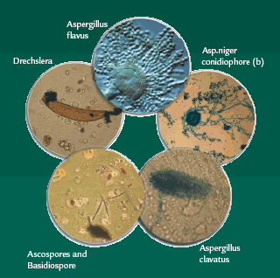

Slide 6
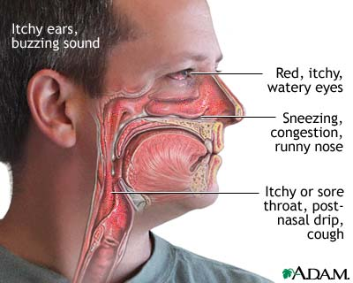

Slide 7
Options
Remediation
It is like ripping out asbestos?
Expensive
The old way
Dry Ice
What? http://www.youtube.com/watch?v=S2TzpW8Pcx8
CalTrex
Will pit metals
Bora Care Mold Care
Can’t be used on non-porous surfaces and does not seal
Bleach
Chlorine Gas
Pushes mold deeper in wood
Do nothing
Not an option when wanting to rent space or keep tenants or sell a house

Slide 8
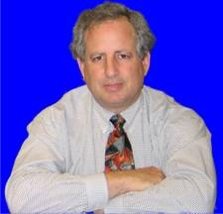
Inventor
Dr. Leonard Pinchuk
World-renowned expert in the field of biomaterials and medical devices
He is a Serial Inventor with over 85 patents
Invention of the nylon angioplasty balloon
Angioplasty Stent
Polymer Delivery System (PDS)
SMTS B

Slide 9
New Technology
Surface Management Treatment System SMTS™ is a two part application used to control bacteria, fungus and mold by cleaning, killing and preventing their return to treated areas.
SMTS A is an EPA registered, multi-purpose, anti-microbial, based in quaternary ammonium salts. It is a bactericide, virucide, disinfectant, fungicide, cleaner, mildew stat and deodorizer.
SMTS B is our unique, proprietary, patented sealer.

Slide 10
The MoldExterm System
SMTS A
Kills a wide range of bacteria, and viruses, such as: resistant strains of E coli, MRSA, Salmonella enterica, RSV, Herpes Simplex Type 1 and 2 and Hepatitis B and C.
SMTS B
*Long lasting and backed by Manufacturer’s Warrantee
Both Products are Non-Staining and can be used on porous and non-porous
*With appropriate renewal system

Slide 11
Dehumidification
You can purchase them at any Big Box Store
Over the Internet
We only use Approved Dehumidifiers (Typically a Santa Fe or the Comfort-Aire Dehumidifier room Dehumidifier)
Santa Fe
11 Merv Filter
12.5 Gallons in one day
5.5 amps
Saves money on conventional units
Saves on Electric Bills
Top Quality Units
Best available in the market

Slide 12
The MoldExterm System
Complete Mold Treatment and Prevention System
W ater Intrusion Inspection
A rticulate the new technology
T reat the mold
E liminates its return
R enewable warranty

Slide 13
Mold in the Wall
Five ways Mold will grow in the wall
Dryer vent vented into a wall void
Cold Air duct running in the wall against a warm wall
Plumbing Leak
Flooding where there is subsequent damage to wallboard
Heavy water intrusion into insulation and drywall

Slide 14
Additional Support
CDC
http://www.cdc.gov/mold/stachy.htm
EPA
http://www.epa.gov/mold/mold_remediation.html
IAQA
http://www.iaqa.org/education/general_info.htm
Minnesota
http://www.mda.state.mn.us/en/sitecore/content/Global/MDADocs/licensing/chemicals/antimicrobialreport.aspx
Mississippi State University Extension Service Department of Forestry
Controlling Mold Growth When Cleaning Flooded and/or Rain-Wetted Homes
http://msucares.com/forestry/topics/documents/14e-mold.pdf

Slide 15
Company Information
Family owned since (when)
Owner Operated means you could call the owners if needed
Fully Trained personnel to make sure the job is done correctly
Guaranteed Service to give you the peace of mind
MoldExterm Partner to assure you receive the best and newest technology
# of locations to help serve you fast and efficient

Slide 16
Conclusion
New Technology
Backed by Manufacturer
MoldExterm Brand
Renewable System
Most Importantly
Our Guarantee and Commitment

Slide 17
Questions
What about the HVAC folks talking about Humidification?
What about Mold in the Walls?
Why not rip it out?
What is the Guarantee?

