Slide 1
The Dauphin County Land Bank
www.DauphinCounty.org

Slide 2
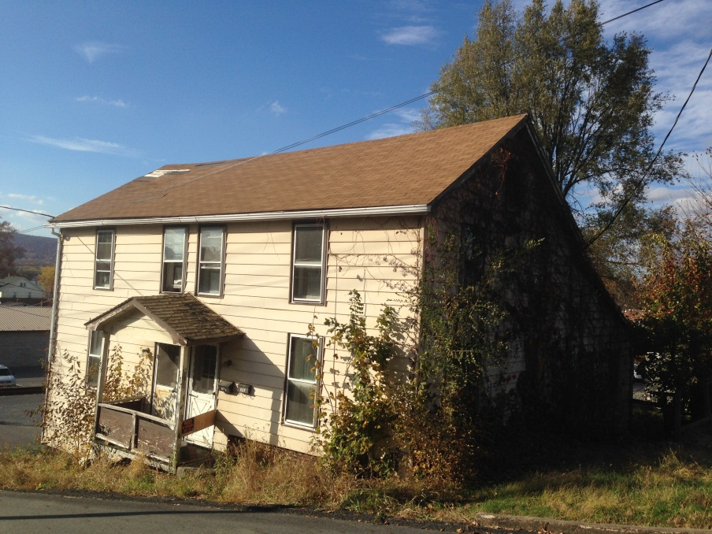
Blight Defining the problem
Vacant /Abandoned / Tax Delinquent Properties
Blight…
Lowers property value on neighboring properties
Increases fire and police protection costs
Decreases tax revenues
Undermines community cohesion
Fills communities with “eyesores”
Allows for more blight
www.DauphinCounty.org

Slide 3
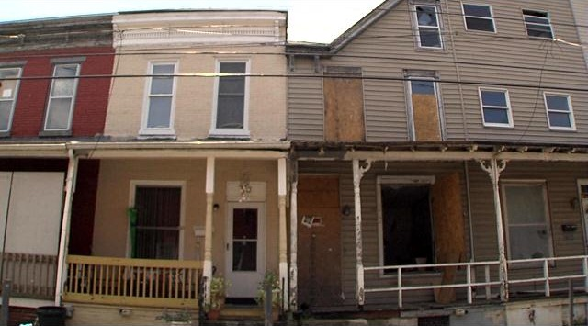
land bank Purpose & Powers
PURPOSE
Identify and remove/prevent
blighted areas
Take control of tax-delinquent, abandoned/vacant properties
Increase property tax collection rate
POWERS
Acquire vacant/abandoned property
May file a court action to quiet title in expedited procedure
Discharge or extinguish existing tax liens
“All powers necessary” to repurpose vacant or abandoned property
Unrestricted in how properties are disposed of
Collecting up to 50% of the real property taxes on properties put back on the tax roll (for the first five years after the transfer)
The Land Bank DOES NOT have the power of eminent domain
www.DauphinCounty.org

Slide 4
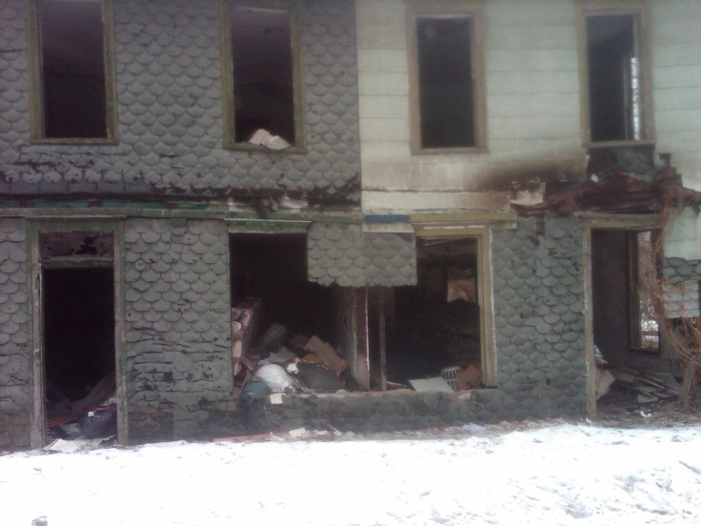
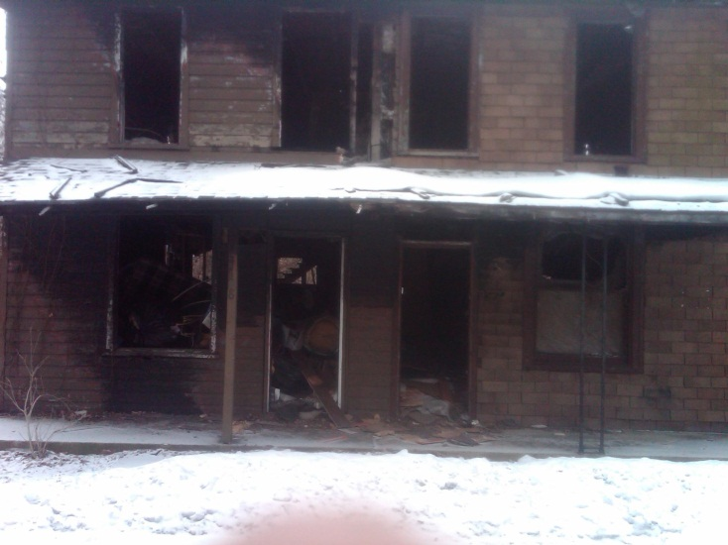
land bank Acquisition & Inventory
Can Acquire Properties…
As gifts or donations
Transfers or exchanges with other entities, foreclosure or purchase
From municipalities
Through Dauphin County Tax Claims
After Acquisition…
Exempt from state and local taxes
Must be in accordance with all applicable laws and codes.
Municipality maintains property per the Memorandum of Understanding
www.DauphinCounty.org

Slide 5
land bank Funding the land bank
PA Land Banks may fund operations through…
Grants and loans from public and private sources
Rents and lease payments or fees for services rendered
Proceeds from property sales
Proceeds from the issuance of tax exempt bonds
Up to 50% of real property taxes collected on properties put back on the tax rolls
Additional Funding Possibilities
Gaming Funds
CDBG
Act 137
The PNC Foundation
The Foundation of Enhancing Communities
Tyco Electronics Foundation
Wells Fargo Regional Foundation
Others Not Yet Defined
www.DauphinCounty.org

Slide 6
Dauphin County land bank Operations
The Land Bank Authority…
Is staffed and maintained through the Dauphin County Office of Community & Economic Development
The Land Bank Authority Board consists of 7 members; 5 of the members also sit on the Redevelopment Authority Board
Matt Tunnell, Chairman
Paul Navarro, Vice-Chairman
Frank Lynch, Treasurer
Gary Lenker, Secretary
Charles Wallace, Assistant Treasurer/Secretary
Andrew Kenworthy
Ron Buxton
Staff communicates with the Dauphin County Tax Claims office to stay up to date with properties on the Repository list, Judicial Sale list and Upset Sale list
Staff is also responsible for working with Municipal leaders to keep up-to-date inventory in each participating municipality
www.DauphinCounty.org

Slide 7
Dauphin County land bank Getting Started
Pilot Program
The Land Bank created a pilot program to include a limited number of municipalities
Targeted 12 of the County’s smaller Municipalities
The Land Bank is still available to those municipalities that were not initially targeted
Of the 12 municipalities originally targeted, 7 have entered in a Memorandum of Understanding with the Land Bank
Millersburg Borough, Highspire Borough, Steelton Borough, Hummelstown Borough, Middletown Borough, Lykens Borough, and Susquehanna Township
The MOU with Susquehanna Twp. has been fully authorized by the School District and the County
The Land Bank has also added an element of Community Involvement
Dauphin County Prison – Project Trade
Dauphin County Vo-Tech
www.DauphinCounty.org

Slide 8
Dauphin County land bank Success & Struggles
Success
$250,000 Gaming Grant from the Dauphin County Commissioners
7 MOUs signed between individual municipalities and the Land Bank Authority
First fully executed MOU between Susquehanna Township, Susquehanna Township School District, and Dauphin County
Struggles
Gaining support of School Districts
Securing additional funding
Lack of PA Land Bank data
Guinea Pig
www.DauphinCounty.org

Slide 9
Dauphin County land bank Resources
Reach out to…
Current Land Banks
Housing Alliance of Pennsylvania
Center For Community Progress
Municipal Leaders
www.DauphinCounty.org

Slide 10
Dauphin County land bank Example
Property “X”
Timeline Without the Land Bank $50,000.00 Assessment (Taxes not Collected)
 | School District | Municipality | Dauphin County
Land Bank Ownership (2014) | - $901.10 | - $255.90 | - $343.80
5 Years | - $4,505.50 (- $901.10/yr) | - $1,279.50 (- $255.90/yr) | - $1,719.00 (- $343.80/yr)
10 Years | - $4,505.50 (- $901.10/yr) | - $1,279.50 (- $255.90/yr) | - $1,719.00 (- $343.80/yr)
Total from 2014-2024 | - $9,912.10 or $0 towards budget | - $2,814.90 or $0 towards budget | - $3,781.80 or $0 towards budget
*Based on 2013-2014 millage rates.
www.DauphinCounty.org

Slide 11
Dauphin County land bank Example
Property “X”
Timeline With the Land Bank $70,000.00 Assessment
 | School District | Municipality | Dauphin County | Land Bank
Land Bank Ownership (2014) | No Tax Income | No Tax Income | No Tax Income | N/A
5 Years | $3,153.85 ($630.77/yr) | $895.65 ($179.13/yr) | $1,202.25 ($240.45/yr) | $5,251.75 50%
10 Years | $6,307.7 ($1,261.54/yr) | $1,791.30 ($358.26/yr) | $2,404.50 ($480.90/yr) | N/A 0%
Total from 2014-2024 | $9,461.55 | $2,686.95 | $3,606.75 | $5,251.75
*Based on 2013-14 Millage Rates.
www.DauphinCounty.org

Slide 12
Dauphin County land bank Example
Property “X”
Difference
Total from 2014-2024 | School District | Municipality | Dauphin County
Without Land Bank | - $9,912.10 | - $2,814.90 | - $3,781.80
With Land Bank | $9,461.55 | $2,686.95 | $3,606.75
Difference | $19,373.65 | $5,501.85 | $7,388.55
*Based on 2013-14 Millage Rates.
www.DauphinCounty.org

Slide 13
Dauphin County land bank Positive Impacts
Cost & Effects
Taxing jurisdictions give up current taxes as an investment to receive increased taxes on improved and reassessed properties
The Land Bank is solely responsible for funding acquisition and any plans for improvements of the property
The Municipality maintains the property while in possession of the Land Bank
50% of the real estate taxes are shared for 5 years
Taxing jurisdiction receive the full amount of real estate taxes on the reassessed value after the first 5 years
Uncalculated Positives
Improving the quality of the neighborhood
Improving the value of neighboring properties
Spurring neighborhood involvement
Sense of neighborhood pride
Earned Income Tax
Occupational Tax
www.DauphinCounty.org

Slide 14
Dauphin County land bank County Commissioners
The Land Bank Authority Board Members were selected by the Dauphin County Commissioners
Jeff Haste, Mike Pries and George Hartwick
www.DauphinCounty.org

Slide 15
The Dauphin County Land Bank
www.DauphinCounty.org

