Slide 1
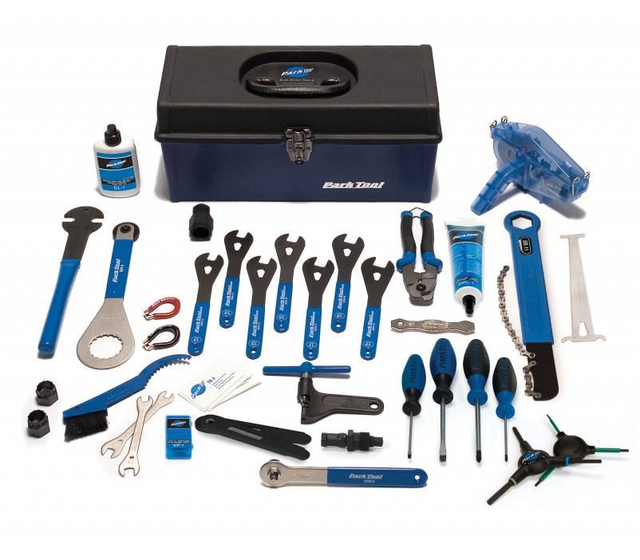
Blighted Properties:
Choosing the Right Tool For the Job
South Central Assembly Workshop
September 2013
Image Source: www.parktool.com

Slide 2
Presenter Background
Chris Gulotta
Executive Director, The Cumberland County Redevelopment and Housing Authorities 1980-2010
Principal, The Gulotta Group, LLC, formed in 2010 to provide training, technical assistance, and strategic planning to communities and organizations in the area of community development and housing
Education
B.A., Dickinson College
Masters in Urban and Regional Planning, Penn State
J.D., Dickinson School of Law

Slide 3

Process
Assess the Nature and Extent of the Problem.
Identify Goals and Objectives.
Develop Evaluation Criteria.
Identify Available Blight Tools.
Evaluate Available Blight Tools Against the Criteria.
Select the Best Tool(s) to Address the Problem.
Image Source: www.123rf.com

Slide 4


Determine How Many Properties in Your Jurisdiction:
Step 1
Assess Nature and Extent of the Problem
Are tax delinquent.
Have a high number of code complaints (including nuisance complaints).
Have municipal liens/delinquent water and sewer bills.
Have been foreclosed upon by a lender.
Image Sources: http://www.gograph.com; www.preferredsalesconcepts.com

Slide 5

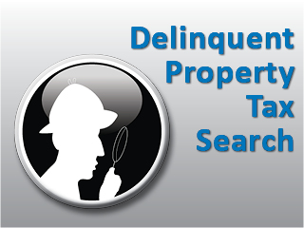
Tax Delinquent Properties
Step 1
Assess Nature and Extent of the Problem
  Talk with your County Tax Claims Director about the location and number of properties in your county/municipality that are:
    Tax delinquent (more than one year past due).
    Unsold after the upset sale stage.
    Unsold at the judicial sale stage.
Image Sources: http://www.cookcountyclerk.com; www.preferredsalesconcepts.com

Slide 6
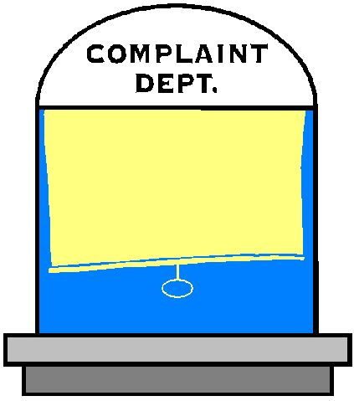
Properties with Numerous Code Complaints
Step 1
Assess Nature and Extent of the Problem
    Set a threshold, e.g., 3-5 complaints in a 12 month period.
    Note those that may pose a health and safety risk in general, and an attractive nuisance to children in particular.
Image Sources: http://www.morgantownwv.gov/; www.preferredsalesconcepts.com

Slide 7

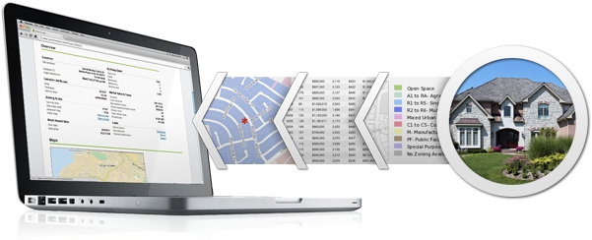
Properties with Municipal Liens or
Delinquent Sewer and Water Bills
Step 1
Assess Nature and Extent of the Problem
Municipal liens should be a matter of public record; your municipality should also maintain a database.
Information on delinquent sewer and water bills for publicly owned utilities (over six months old) should be readily available.
Image Source: http://www.point2.com www.preferredsalesconcepts.com

Slide 8

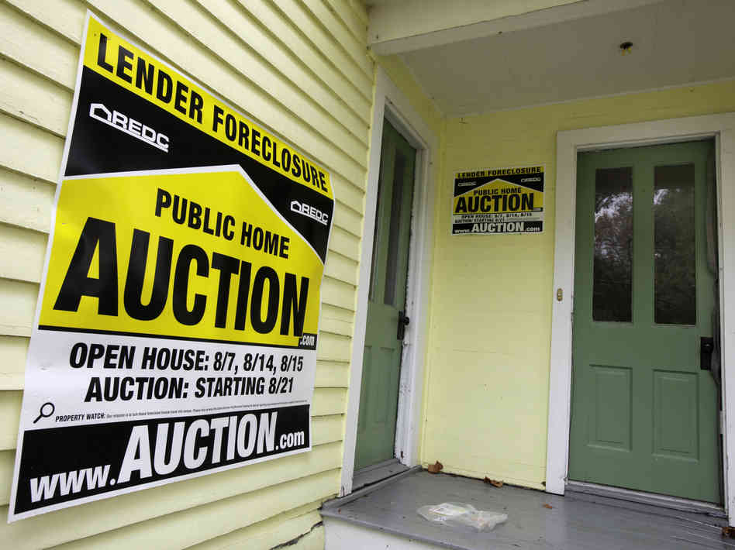
Properties That Have Been Foreclosed On
By a Lender
Step 1
Assess Nature and Extent of the Problem
Check government insured mortgage websites:
  HUD (FHA) www.hudhouses.com
  Fannie Mae www.homepath.com
  Freddie Mac www.homesteps.com
Image Source: http://www.npr.org; www.preferredsalesconcepts.com

Slide 9

Map the Properties
Step 1
Assess Nature and Extent of the Problem
Using Google Maps (or a GIS program), map
the properties to see if there is a concen-
tration in one area.
See if there is a concentration of properties that are located on gateway streets, in established revitalization areas, or in floodplains.
It may make sense to target properties in these areas to the extent that a redevelopment opportunity exists.
Note: This is good project for a local college or university class!
Image Source: http://www.techwhack.com; www.preferredsalesconcepts.com

Slide 10
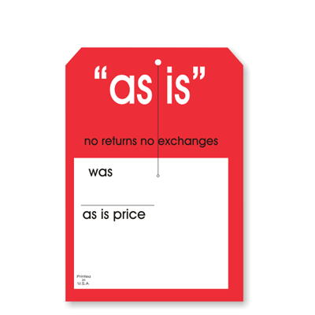
Step 1
Assess Nature and Extent of the Problem
Determine the As-Is Value of the Property
Look up assessed value of each property to determine the value of the property “as is.” The information about the current value of the property is important because it may affect your ability to borrow against the property to undertake repairs.
If the property has little or no value “as is” except for the value of the land, you will be unable to recoup the cost if you acquire and demolish the property.
Note: some assessed values may under- or over-
state property value, so you may have to use your
judgment based on what you know about property
values in the area.
Image Source: www.xpresstags.com

Slide 11


Step 1 Assess Nature and Extent of the Problem
Collect Data on the Properties
1. Determine whether the property is blighted under Section 204 of PA Eminent Domain Code.
2. Determine whether the property is vacant, and estimate for how long.
3. If the property is vacant and blighted, determine whether it is being actively marketed.
4. Determine whether neighbors have made numerous police calls for suspicious activity, e.g., drug activity.
5. Determine whether the property is owner-occupied.
7. Decide what action to take regarding the property.
6. Even if the property is owner-occupied and not blighted, there may be a reason to acquire the property at tax sale stage. It may also make sense to acquire a property that isn’t blighted if there is an emerging redevelopment opportunity.
*
*
Image Sources: http://www.techwhack.com ; www.preferredsalesconcepts.com
*
http://www.legis.state.pa.us
/WU01/LI/LI/CT/PDF/26/26.PDF

Slide 12
Step 2
Identify Goals and Objectives
Prevention
Remediation
Redevelopment

Slide 13

Step 2
Identify Goals and Objectives: Prevention
If the number of problem properties is relatively small, you may want to focus on Prevention Strategies :
  Systematic Code Enforcement
  Rental Licensing and Inspections
  Ticketing Ordinances
  Programs to Incentivize Private Development
  Disqualification of Property Owners at Tax Sales
  Note: For those few blighted properties, assuming they are also
  vacant, you may want to consider a more targeted remediation
  approach such as conservatorship, acquiring the property with
  Community Development Block Grant funds, or eminent domain
  through the Redevelopment Authority.
Image sources: www.cidreview.cidmcorp.com; www.theamateurconsumer.com

Slide 14


Systematic Code Enforcement
Step 2
Identify Goals and Objectives: Prevention
  Proactive vs. Reactive: regular sweeps of areas of the municipality, (at least twice a year) rather than on a complaint basis only
  Exterior Inspection of buildings and parcels only (usually); however, this may trigger an interior inspection, as a structural condition may be visible from the outside
  Effectively Remediates Unsightly Conditions such as high weeds and grass, trash, abandoned vehicles/appliances/ furniture
  Requires Additional Staff, but complements other neighborhood investments such as curb and sidewalk repairs, owner occupied housing rehabilitation program, and home-ownership programs
Image sources: www.cidreview.cidmcorp.com; www.theamateurconsumer.com; www.oriskanyfd.com

Slide 15

Rental Licensing and Inspections
Step 2
Identify Goals and Objectives: Prevention
  Usually Requires Registration of each rental unit, occupants’ names, and landlord contact information
  License Can be Denied if community has implemented Act 90 of 2010
  Ordinance Can be Enacted requiring absentee owners to provide contact information for a local manager or realtor
  Inspection Timeframe: can be on annual basis but, usually no less than once every three years
  Contracting Out Inspections; fee charged inspections can cover this cost (To avoid litigation, be sure the fee never exceeds the actual cost of the registration and inspection program.)
Image sources: www.cidreview.cidmcorp.com; www.theamateurconsumer.com; duplexchick.com

Slide 16


Ticketing Ordinances
Step 2
Identify Goals and Objectives: Prevention
Property owner is given a warning
Police issue a code violation ticket
Owner pays fine (usually around $25)
If owner does not take corrective action, municipality files charges with the District Justice
Image sources: www.cidreview.cidmcorp.com; www.theamateurconsumer.com; www.activerain.com

Slide 17

Programs to Incentivize Private Development
Step 2
Identify Goals and Objectives: Prevention
  State Laws which phase in taxes on improvements to
  residential and commercial real estate
  Historic District Ordinances that allow owners of income-
  producing properties to qualify for state and federal
  credits
  Objective: to encourage private investment in a
  community through tax policy.
Image sources: www.cidreview.cidmcorp.com; www.theamateurconsumer.com; www.blog.sparkhire.com

Slide 18

Disqualification of bidders at tax sales
Step 2
Identify Goals and Objectives: Prevention
Disqualify owners that have not lived up their obligations as property owners from purchasing more property as a tax sale .
This includes landlords with:
  Outstanding Code Violations
  Delinquent Taxes
  Delinquent Utilities
  A Revoked Rental Housing License
Image sources: www.cidreview.cidmcorp.com; www.theamateurconsumer.com; www.blog.sparkhire.com

Slide 19

Remediation Strategies
Step 2
Identify Goals and Objectives: Remediation
Implement provisions of Act 90 of 2010
Charge Chronic Code Violators with the Crime of Municipal Code Avoidance
Conservatorship
Land Banking
Note: If the blighted property problem is widespread,
you will still want to include prevention strategies
to stem the number of properties that may
become blighted in the future.
Image Source: www.pul.se

Slide 20
Implement Provisions of Act 90 of 2010
Step 2
Identify Goals and Objectives: Remediation
Possible Actions in the event of a code violation…
  Deny or revoke rental housing license
  File municipal liens against the subject property…
  And any other property in the Commonwealth belonging to the same owner.
  For costs incurred in the event the owner does not take corrective action i.e., demolition of property, cutting weeds and grass, repairing/replacing sidewalks.
Image Source: www.pul.se

Slide 21
Charge Chronic Code Violators with
The Crime of Municipal Code Avoidance
Step 2
Identify Goals and Objectives: Remediation
  May be charged if the code violation remains unabated after four summary convictions for the same violation
  If convicted, the property owner is guilty of a
  2nd Degree Misdemeanor, and may be incarcerated.
Image Source: www.pul.se

Slide 22
Conservatorship
Step 2
Identify Goals and Objectives: Remediation
  Conservatorship allows certain entities to petition the Court of Common Pleas to make corrective repairs to a property when the owner has been uncooperative.
  The conservator prepares a plan for the repairs/ demolition, subject to the Court’s approval.
  With the Court’s permission, the conservator may borrow against the property to fund repairs/ administrative costs.
Image Source: www.pul.se

Slide 23


Land Banks: Specific Powers
Step 2
Identify Goals and Objectives: Remediation
    Acquire real estate and…
    Maintain, demolish or improve the property.
    Sell the property for redevelopment.
    Lease the property, consistent with state law.
    Accept the assignment of tax liens from
    municipalities.
    File action to quiet title for properties it owns.
Image Source: http://josephagibsonlibrary.blogspot.com

Slide 24


Land Banks:
What Jurisdictions are Eligible?
Step 2
Identify Goals and Objectives: Remediation
  Municipalities (cities, boroughs, townships) over 10,000 in population
  Counties (regardless of population)
  Two or more communities with a population under 10,000 forming an inter-cooperation agreement to establish a land bank
  Note: If a community forms a land bank, a county
  land bank may only operate in the areas
  outside of that community.
Image Source: www.nationalschoolofaccountancy.com

Slide 25

Land Banks:
Methods for Acquiring Property
Step 2
Identify Goals and Objectives: Remediation
  Voluntary sale or donation
  For the upset price, if no one bids higher than minimum bid
  For a negotiated figure with the Tax Claim Bureau
  at the judicial sale stage
  From the Tax Claim Bureau Repository of Unsold Property
Image Source: www.redcarpetproperties.in

Slide 26

Land Banks:
Other Considerations
Step 2
Identify Goals and Objectives: Remediation
  Lands banks do not possess the power of eminent domain.
  Land banks are subject to the Sunshine Act and
  Right-to-Know Law.
  Lands banks may sell real estate without going through a competitive process.
  A land bank may enter a contract with
  a municipality for staffing services.
Image Source: www.gmdistrictscouting.org

Slide 27

Step 2
Identify Goals and Objectives: Redevelopment
If the blighted properties are strategically located and may be good sites for redevelopment projects, tools such as eminent domain and voluntary sale may also be appropriate.
Image Source: www.txagtalks.texasfarmbureau.org

Slide 28
Step 2
Identify Goals and Objectives: Redevelopment
Eminent Domain
  Urban Redevelopment Law permits Redevelop-ment Authorities to address spot blight by acquiring single, vacant, blighted properties.
  Redevelopment Authorities may also acquire multiple properties for redevelopment.
  The Redevelopment Authority drafts a
  Redevelopment Area Plan.
  The properties do not have to be vacant.
  51% of the parcels in the Redevelopment
  Area must be blighted.
Image Source: www.txagtalks.texasfarmbureau.org

Slide 29

Step 2
Identify Goals and Objectives: Redevelopment
Voluntary Acquisition
  Voluntary acquisition is always an option if
  there is a willing seller.
  Funding sources include Community Development
  Block Grants.

Slide 30

Step 3
Develop Evaluation Criteria
Legal Constraints
Effectiveness
Cost/Risk
Political Viability
Image Source: www.convenienceinnovation.com

Slide 31

Step 3
Develop Evaluation Criteria: Legal Constraints
Potential Legal Barriers to Using a Strategic Tool Include Requirements…
  That the property be vacant.
  That the property meet one or more blighted criteria under state law.
  That the property not be actively marketed.
  That the property not be subject to foreclosure.
Image Sources: www.guardian.co.uk; www.convenienceinnovation.com

Slide 32

Step 3
Develop Evaluation Criteria: Effectiveness
Will it Achieve the Desired Results?
Example: Neighborhood Crime Decreased by 25% over 5 Years
Example: Number of Blighted Properties Reduced by 50% Over 5 Years
Image Sources: www.presentermedia.com; www.convenienceinnovation.com

Slide 33

Step 3
Develop Evaluation Criteria: Costs/Risks
What Costs/Risks Are Associated With the Strategic Tool?
If acquired, is there a market for the property, or will it be held for a period of years before it is redeveloped?
What are the estimated costs of holding onto the property for an extended period of time?
What financial resources are required to make use of the tool (legal/acquisition costs, etc.)?
Are those resources available?
Does the entity have the administrative capacity required to effectively utilize the tool?
If the capacity doesn’t exist, what is the cost of acquiring that expertise?
Image Sources: www.nextyearagain.blogspot.com; www.convenienceinnovation.com

Slide 34

Step 3
Develop Evaluation Criteria: Political Viability
Is the tool under consideration one that might be politically contentious (e.g., eminent domain)?
Is the location of the blighted property prominent so there may be a willingness of the local government to expend resources to deal with it?
Is the blighted property
occupied, and will acquisition
of the property cause the
occupant to be displaced?
Image Sources: www.23rf.com; www.convenienceinnovation.com

Slide 35


Step 4
Identify Available Blight Tools
Ticketing ordinance
Act 90-permit denial
Conservatorship Law
Land Banks
Eminent Domain
Image Source: www.investmentpropertycentral.org

Slide 36

Step 4
Identify Available Blight Tools: Ticketing Ordinance
A Ticketing Ordinance…
May require police role (to issue tickets)
Will generate revenue to offset cost of program
Usually has a very high rate of compliance
May be more politically acceptable if property owner (tenant) is given warning first
Image Sources: www.americancowboychronicles.com; www.investmentpropertycentral.org

Slide 37

Step 4
Identify Available Blight Tools: Act 90 Permit Denial
Denial of a Permit …
May gain the attention of the property owner, especially if there is a rental housing licensing ordinance.
Is not permissible if the owner indicates a willingness to undertake repairs.
Image Sources: www.utah-concealed-carry-permit.com ; www.investmentpropertycentral.org

Slide 38

Step 4
Identify Available Blight Tools: Conservatorship Law
Under the conservatorship law the property must..
Be vacant.
Not be actively marketed for sale.
Not subject to foreclosure.
Meet 3 or more definitions
of blight.
Image Sources: www.agimpylife.com ; www.investmentpropertycentral.org

Slide 39

Step 4
Identify Available Blight Tools: Land Banks
Land Banks are useful tools for holding property, particularly when there is no market in the short term.
Entities may be able to acquire property at a lower cost from the Tax Claim Bureau and quiet title.
Consideration: What is the source of funds used to acquire and maintain the property before it is conveyed to ultimate user?
Image Sources: http://savepottstown.com ;www.investmentpropertycentral.org

Slide 40
Step 4
Identify Available Blight Tools: Eminent Domain
Considerations:
Eminent Domain takes up to 24 months to complete.
Legal costs are high.
The property must be vacant if Spot Blight Provisions of Urban Redevelopment Law are used.
This tool may be politically unacceptable
because of concern about “Big Government.”
Eminent Domain may be the best blight
tool if all other options have been exhausted
and/or the property is needed for a redevelop-
ment project.
Image Sources: www.txagtalks.texasfarmbureau.org ; www.investmentpropertycentral.org

Slide 41

Step 5: Evaluate Available Blight
Tools Against the Criteria
Tool | Legal Constraints | Effectiveness | Costs/Risks | Political Viability
Act 90 Permit Denial | *Requires 6 month waiting period *Requires serious code violations/delinquent taxes or utilities | High | Low/Low | High
Ticketing Ordinance | Must meet code violation definitions in property maintenance code | Low (chronic problem properties) | Low/Low | High
Conservatorship | *Must be Vacant *Must Not be Actively Marketed *Must Meet 3 of 9 Conditions of Blight | High (if there are relatively few blighted properties) | Medium/ Medium | High
Land Banks | *Requires intergovernmental agreement to discharge tax liens *Population must be greater than 10,000 | High (if there is a large number of blighted properties) | Medium/ Medium | Medium
Eminent Domain | *Must Be Vacant (Spot Blight) *Must Meet 1 or More Eminent Domain Law Criteria | High | High/Low | Low
Image Source: www.blog.mrren.com

Slide 42

Step 6
Select the Best Tool(s) to Address the Problem
Considerations:
There may be more than one tool that is
a good fit. For example, where the number of blighted properties is fairly limited, a ticketing ordinance in tandem with a conservatorship program might be an effective combination.
The best strategic tool may not be practical. For example, where the political environment is strained, eminent domain may not be a viable option.
Image Sources: www.makingadifferencetogether.blogspot.com

Slide 43
Conclusion
Municipalities should feel good about the fact that the legislature has provided effective tools to deal with blighted properties.
Choosing the right tool to address blight requires some research, an understanding of how the different tools work, and some thought about which tool is the best under the circumstances.

Slide 44
Christopher Gulotta
The Gulotta Group, LLC
448 C Street
Carlisle, PA 17013
gulottagroup@pa.net
www.gulottagroup.com
717-580-0439

