Slide 1
Sink or Swim
Strategies for Non-Profit Organizations to
Remain Viable During Tough Times
April 10, 2013
Notes:
Fiscal Cliff
Budget Cuts
Impacts on Bottom Line
Social Enterprise
Funding Diversification
Consolidation
Duplication
Fundraising/Endowments

Slide 2
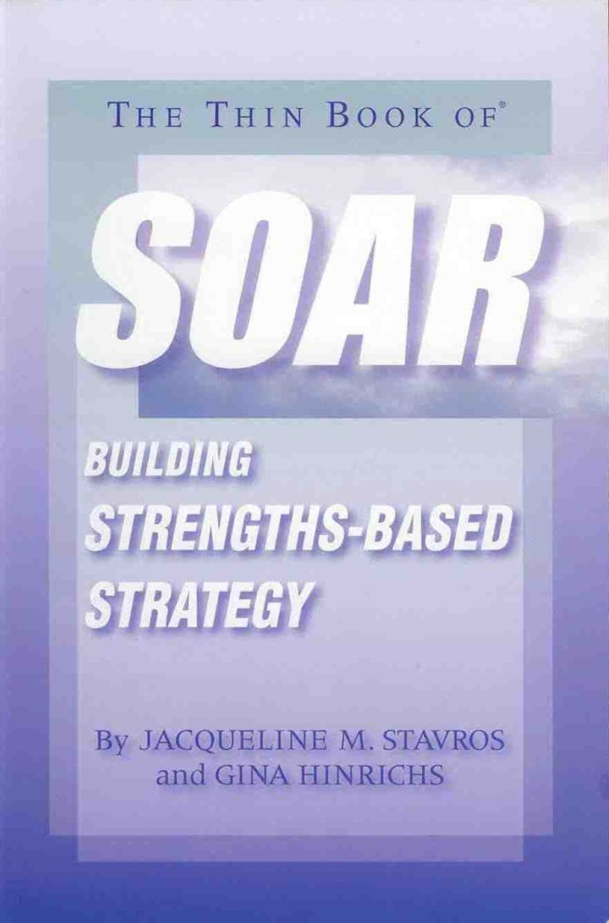
Start with a PLAN!
Understand the clear challenges and opportunities
Identify Strengths and Weaknesses of the Organization
Cultivate Clear Priorities and Best Practices
Be Patient and Committed to Change
Notes:
We talked a bit yesterday about planning and opportunities. In blight reclamation, in housing development and in organizational development, we need a strategic road map to help guide the process. Keeping our heads up, this process will help us to get to know ourselves, the role we play in our communities and by keeping our ears open, hear of potential ways to identify opportunities for ourselves in the changing economy.
A strategic plan is a tool that provides guidance in fulfilling a mission with maximum efficiency and impact. If it is to be effective and useful, it should articulate specific goals and describe the action steps and resources needed to accomplish them. As a rule, most strategic plans should be
reviewed and revamped every three to five years.
An operating plan is a coordinated set of tasks for carrying out the goals delineated in a strategic plan. It thus goes into greater detail than the
strategic plan from which it is derived, spelling out time frames and the roles of individual staff and board members, for example. It also has a
shorter horizon than a strategic plan — usually one fiscal year.
A business plan is typically focused on the actions and investment necessary to generate income from a specific program or service. A business plan includes information about an organization’s products, competitive environment and revenue assumptions.
A case statement is geared toward marketing and fundraising rather than planning. It describes the organization’s goals, capabilities and
strengths and the benefits it provides. Its purpose is to secure contributions and grants from individuals, foundations, corporate giving programs and other philanthropic entities.
briefing paper

Slide 3
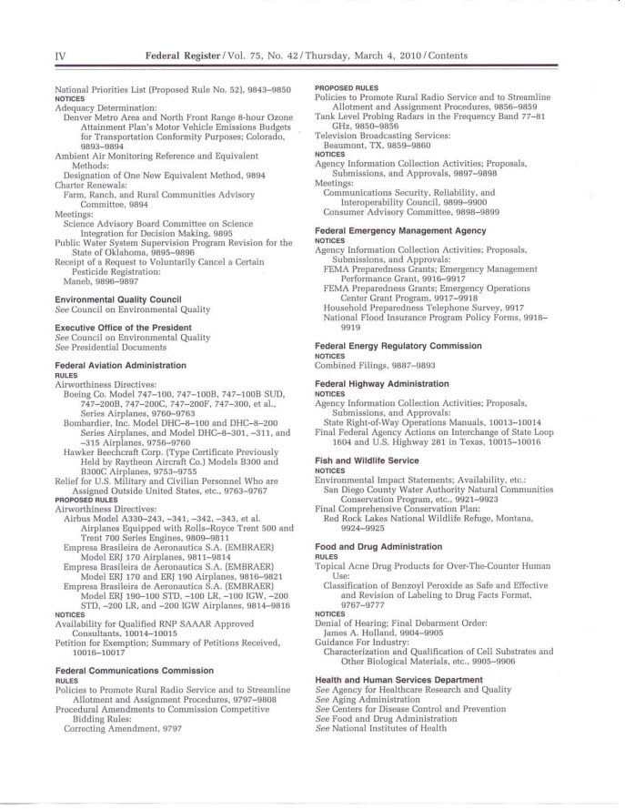
Identify Opportunities
Identify community needs and changes in market requirements
Have regulations changed effecting projects or developments?
Do you have a niche in the Market?
What role can you play?
Notes:
What a strategic plan can do is shed light on an
organization’s unique strengths and relevant
weaknesses, enabling it to pinpoint new opportunities
or the causes of current or projected problems.
If board and staff are committed to its
implementation, a strategic plan can provide an
invaluable blueprint for growth and revitalization,
enabling an organization to take stock of where it
is, determine where it wants to go and chart a
course to get there.

Slide 4
Cultivate Opportunities
Share Services, Space or Staff (…when merger isn’t for you…)
Identify Innovative Approaches
Develop the business plan to sell your organization’s skills and strengths
Cultivate Board and Community Support
Notes:
Example:
TCHDC/CAC – when merger isn’t for you…
Supportive Services Model
PHFA Changing Regulations
Cost cutting measures at HUD that lead to Housing Authorities grasping for opportunities
CAC supported critical programs with federal entitlement dollars. Calling our supportive services the “bread and butter” of what we do and then funding it in an unsustainable way

Slide 5
For more information
Contact:
Kathy Possinger, Executive Director
Community Action Commission
kpossinger@cactricounty.org
(717) 232-9757
@kathypossinger
Notes:
Tools – Creative Acquisition strategies, use all of the tools available in creative ways – Eminent Domain/Condemnation/ Code enforcement, judicial sales, private donation, amicable purchase. Build a strong relationship with your Redevelopment Authority and look to use their tools creatively.
Funding – Develop partnerships with local and regional foundations – Wells Fargo Regional Foundation
Seek Tax Credit Funding to jump-start redevelopment strategies – in many communities the Neighborhood Assistance Tax Credit, Special Program Priorities Tax Credit and Neighborhood Preservation Tax Credit programs are under utilized. Work together with partners in the private sector to pool resources and create opportunities through the tax credit investment = win/win for all parties.

